Slide 1

Capstone Project - PSI
CRISP-DM Framework analysis
Heart Disease prediction using machine learn
Lecturer: Dr. Muhammad Iqbal Students: Luiza Cavalcanti Albuquerque Brayner (2020309) Edgard Pacheco (2020332)

Slide 2
Introduction
Innovative health tracking and disease prevention application.
Machine Learning for personalized user insights and predictive analytics.
Health predictions and preventive health care aid.
Well-being management and guidance to potential disease risks.

Slide 3
Project Plan
Week 1: Business understanding, gather requirements, define objectives.
Week 2: Data understanding, explore datasets, check data quality.
Week 3: Data preparation, cleaning, transforming, and integrating data.
Week 4: Evaluation, assess model performance, deploy solution, present findings.
Collaboration tools: Google Docs, Google Colab, Google Slides, Google Meet, GitHub.

Slide 4

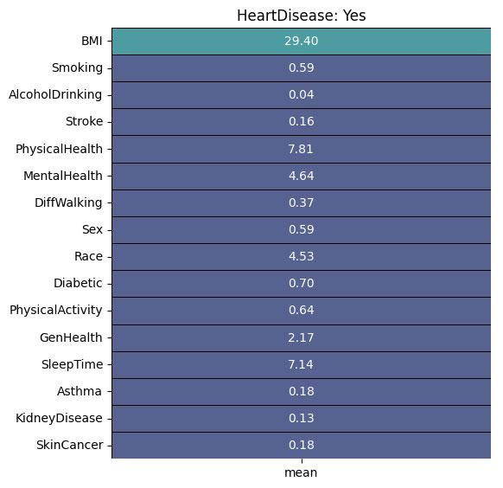

Data Investigation and Understanding
Visualization and Understanding
Dataset attributes: age, gender, smoking habits, alcohol consumption, physical activity, health metrics.
Issues: Missing family medical history and genetic predispositions.
Privacy and Ethical concerns: Compliance with regulations such as GDPR.

Slide 5
CRISP-DM Framework
Business Understanding: Define objectives.
Data Understanding: Explore datasets, check data quality.
Data Preparation: Clean and integrate data, feature engineering.
Modelling: Logistic Regression, Decision Tree, Random Forest.
Evaluation: Assess model performance (Accuracy, Precision, Recall, F1-Score).
Deployment: Prototype implementation, user feedback, documentation.

Slide 6
Modelling Techniques
Logistic Regression: - Accuracy: 91.61% - Chosen for deployment due to high precision and recall for heart disease prediction.
Decision Tree: - Accuracy: 91.54% - Lower cross-validation score, potential overfitting.
Random Forest: - Accuracy: 91.52% - Good performance, but lower than Logistic Regression.
Final Model: Logistic Regression.

Slide 7
Evaluation and Results
Metrics: - Accuracy, Precision, Recall, F1-Score, ROC - AUC score.
Insights: - Key predictors of heart disease based on available features: smoking, alcohol consumption, physical activity. - Correlation Matrix: Shows relationships between variables. - Classification Report: Performance of Logistic Regression.
Results: - Healthcare advancements; - Early disease detection; - Preventative care; - Accessible and efficient;

Slide 8
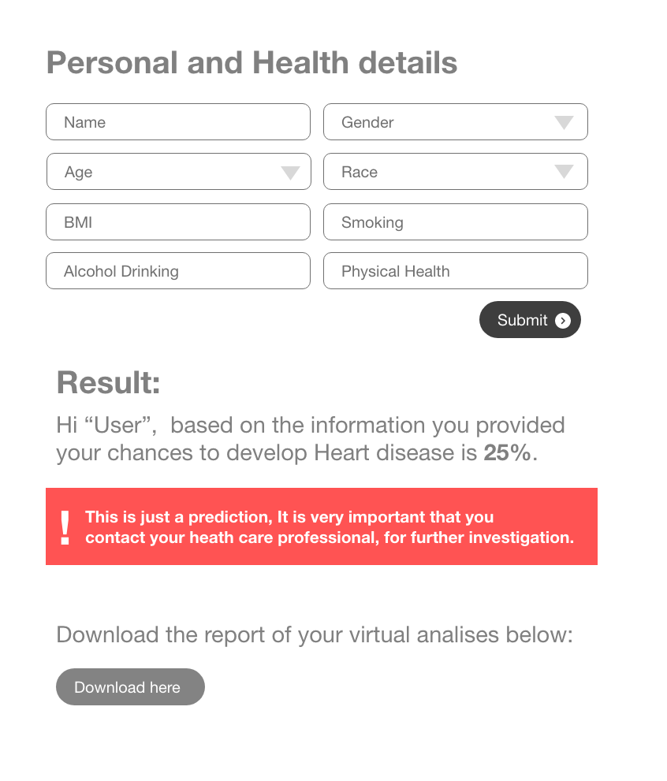
Prototype Wireframe

Slide 9
Conclusion and Future Improvements
Summary:
- Prototype of a health tracking and disease prediction application. - Effective use of Machine Learning for predictive analytics. - Logistic Regression modeling usage.
Society Impact:
- Identification of potential risk factors for heart disease.
- Empowers users for proactive health Management.
Future Enhancements:
- Improve model accuracy, include more health factors.
- Ensure compliance with legal and ethical standards.

